Slide 1
TIME SERIES ANALYSIS IN R
Name | Reg Number | Student Number
OMACHOL JAMES | 16/U/10996/EVE | 216016969
SSEBUUFU EDDY | 16/U/11524/PS | 216010233
NSUBUGA MOSES | 16/U/10473/PS | 216009009
KAZIBWE DAVIS | 16/U/5821/EVE | 216007850

Slide 2
Definition
a series of values of a quantity obtained at successive times, often with equal intervals between them is called a TIME SERIES
Time series data are bivariate data in which one of the variables is the time represented in the x-axis

Slide 3
Objectives
To study the past behaviour of data.
To make forecast for the future.
To understand the present in a more efficient way.
Further it helps in business planning.

Slide 4
COMPONENTS OF TIME SERIES
Trend
The trend is a general direction in which some thing is developing or increasing
2. Seasonal
reflect “normal” variations that recur every year to the same extent, e.g. weather fluctuations that are representative of the season, length of months, Christmas effect.
3. Irregular
The irregular component of a time series is the residual time series after the trend-cycle and the seasonal components (including calendar effects) have been removed.

Slide 5
Time series models
Autoregressive model (AR)- An autoregressive model is when a value from a time series is regressed on previous values from that same time series.
Moving average model (MA)- specifies that the output variable depends linearly on the current and various past values of an imperfectly predictable term.
AutoRegressive Moving Average model(ARMA)- includes both AR and MA models representation
AutoRegressive Integrated Moving Average model(ARIMA)- is a generalization of an autoregressive moving average (ARMA) model

Slide 6
Categories of time series modelling
Stationary series.
Random walks.
Dickey Fuller Test.

Slide 7
Stationary series
A stationary series is one whose properties do not depend on the time at which the series is observed.
There are three basic criterion for a series to be classified as stationary series .
1- The mean of the series should not be a function of time rather should be a constant.
2- Variance of a series should not be a function of time.
3- Covariance (autocorrelation) of the ith term and (i+m)th should not be a function of time. ie it should be constant.

Slide 8
Why do I care about ‘stationarity’ of a time series?
Until unless you time series is stationary you can not build a time series model.
In case where the stationary criterion is violated
First stationarise the time series and then try stochastic model to predict the time series.
How to test if a series is stationary
Use Augmented Dickey-Fuller Test (adf test). A p-Value of less than 0.05 in adf.test() indicates that it is stationary.
adf.test(tsData) # p-value < 0.05 indicates the TS is stationary

Slide 9
How to make a time series stationary?
Differencing a time series
In order to make your series stationary, you take a difference between the data points. So let us say, your original time series was:
X1, X2, X3,..........., Xn
Your series with difference of degree 1 becomes:
(X2 - X1, X3 - X2, X4 - X3,......., Xn - X(n-1)
Transforming the time series
If you can not make a time series stationary, you can try out transforming the variables. Log transform is probably the most commonly used transformation, if you are seeing a diverging time series. However, it is normally suggested that you use transformation only in case differencing is not working.
other methods include
– De-tranding , - Seasonal adjustments

Slide 10

Random walk
This is the most basic concept of the time series.
where Er(t) is the error at time point t.
Now, if we recursively fit in all the Xs, we will finally end up to the following equation

Slide 11
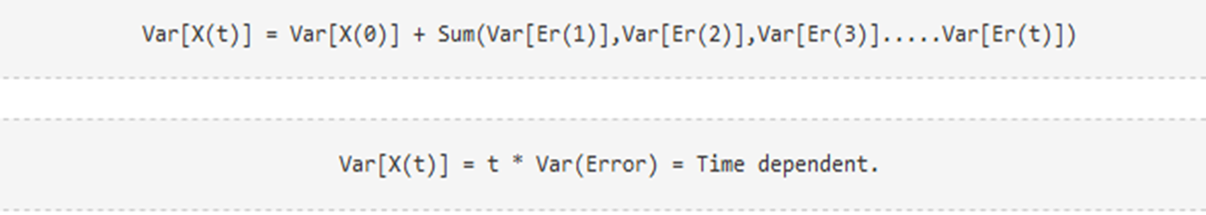
Random walk continuation
1. Is the Mean constant ?
We know that Expectation of any Error will be zero as it is random.
Hence we get E[X(t)] = E[X(0)] = Constant.
2. Is the Variance constant?
Hence, we infer that the random walk is not a stationary process as it has a time variant variance. Also, if we check the covariance, we see that too is dependent on time.

Slide 12
Random walk continuation
Since random walk is not stationary we then introduce the Rho coefficient.
The Rho coefficient try to make the random walk stationary through the formula.
X(t) = Rho*X(t-1) + Er(t)

Slide 13
Analysis of Time Series
The purpose of analysis of time series is to decompose it into various components.
There are two models based on the assumption regarding the manner in which these components have combined.
They include Additive Model and Multiplicative Model
Additive Model
This model is based on the assumption that the value of the variables of a time series at a point of time t is the sum of the four components.
Symbolically it can be written as
Yt = Tt + St + Rt
This model assumes that the three components act independently. i.e one component has no effect on others irrespective of their magnitudes

Slide 14
Multiplicative model
This model assumes that as the data increase, so does the seasonal pattern. Most time series plots exhibit such a pattern. In this model, the trend and seasonal components are multiplied and then added to the error component.
Yt = Tt * St + Rt

Slide 15
Frame work and Application of ARIMA Modeling in R
This framework specifies the step by step approach on How to do a Time Series Analysis. They include the following steps
Step 1: Visualize the Time Series
It is essential to analyze the trends prior to building any kind of time series model.
Step 2: Stationarize the Series
Once we know the patterns, trends, cycles and seasonality , we can check if the series is stationary or not.
Step 3: Find Optimal Parameters
The parameters p,d,q can be found using ACF and PACF plots.

Slide 16
Frame work and application of ARIMA model in R cont.…..
Step 4: Build ARIMA Model
With the parameters in hand, we can now try to build ARIMA model. The value found in the previous section might be an approximate estimate and we need to explore more (p,d,q) combinations
Step 5: Make Predictions
Once we have the final ARIMA model, we are now ready to make predictions on the future time points. We can also visualize the trends to cross validate if the model works fine.

Slide 17
Model | ACF | PACF
AR(p) | Spikes decay towards zero | Spikes cut off to zero
MA(q) | Spikes cut off zero | Spikes decay towards zero
ARMA(p,q) | Spikes decay towards zero | Spikes decay toward zero

Slide 18
codes for time series analysis we are using a dataset “AirPassengers”
#importing data
data(AirPassengers)
#shows the that the data series is in time series format.
class(AirPassengers)
# This is the start of the time series
start(AirPassengers)
# This is this end of the time series
end(AirPassengers)
#the cycles of this time series is 12 months in a year
frequency(AirPassengers)
# Shows how the number of passengers across the spectrum
summary(AirPassengers)

Slide 19
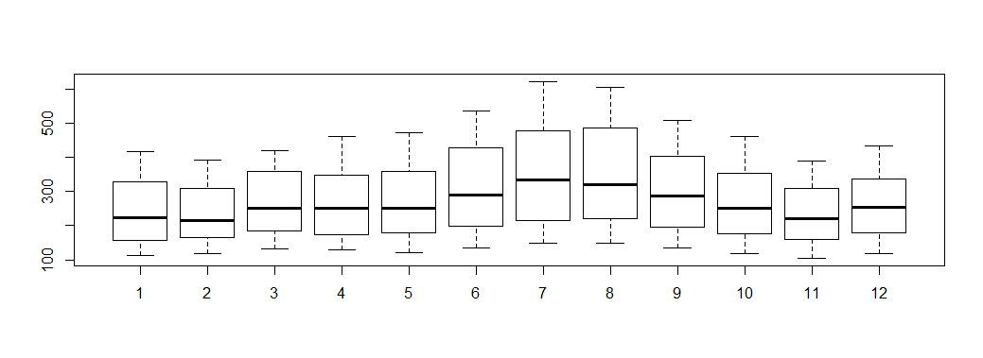
#sense of seasonal effect boxplot(AirPassengers~cycle(AirPassengers))

Slide 20
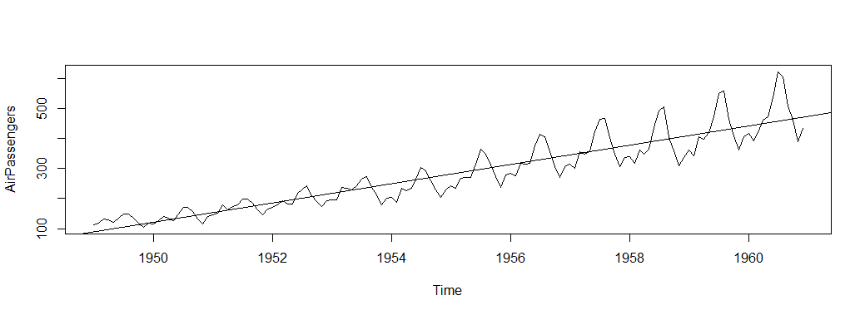
#for mean plot(AirPassengers) abline(reg =lm(AirPassengers~time(AirPassengers)))

Slide 21
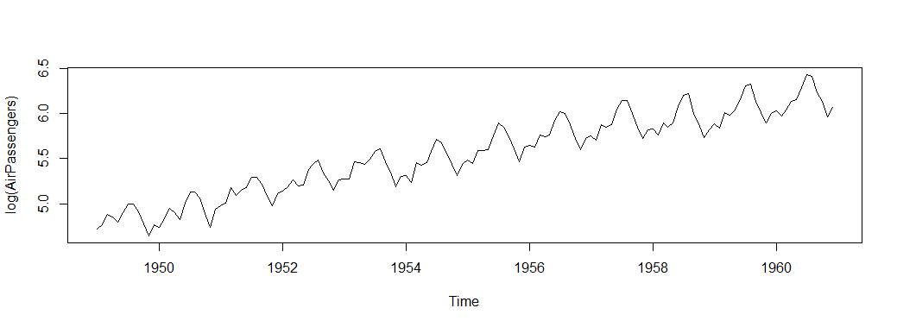
# make variance equal plot(log(AirPassengers))

Slide 22
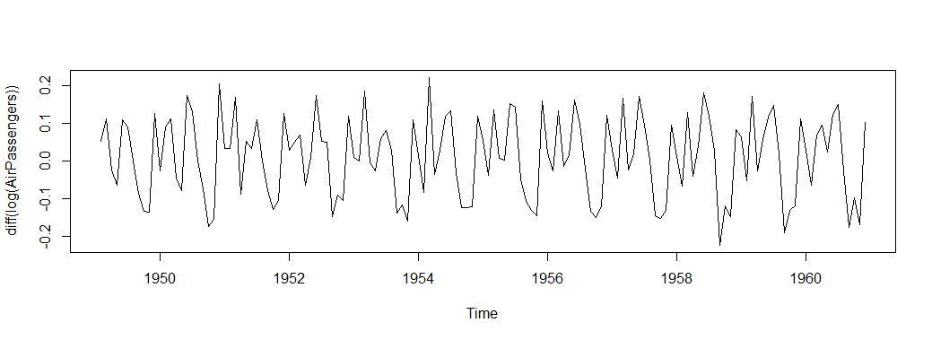
# makes mean constant plot(diff(log(AirPassengers)))

Slide 23
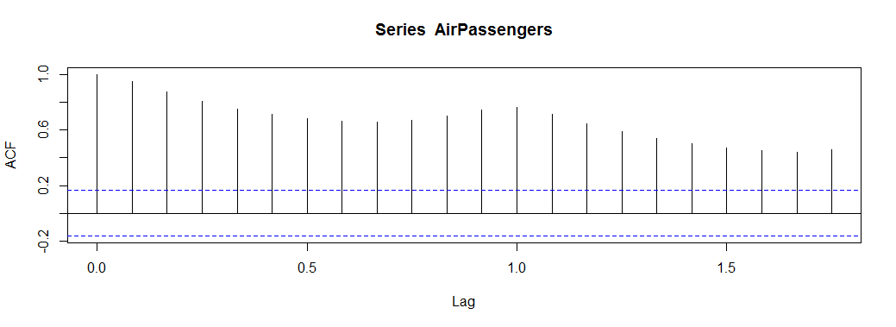
# determining values of p d and q to be used in the arima model )# series are not stationary acf(AirPassengers

Slide 24
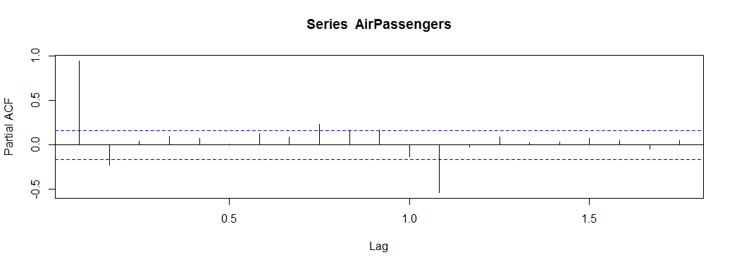
#use of pacf function pacf(AirPassengers)

Slide 25
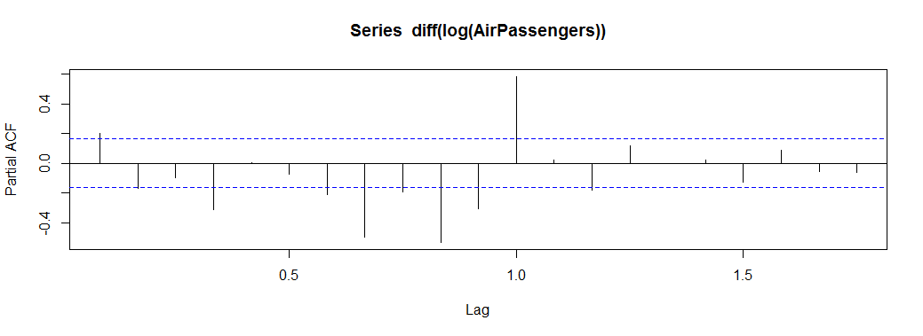
# determines value of p pacf(diff(log(AirPassengers)))

Slide 26
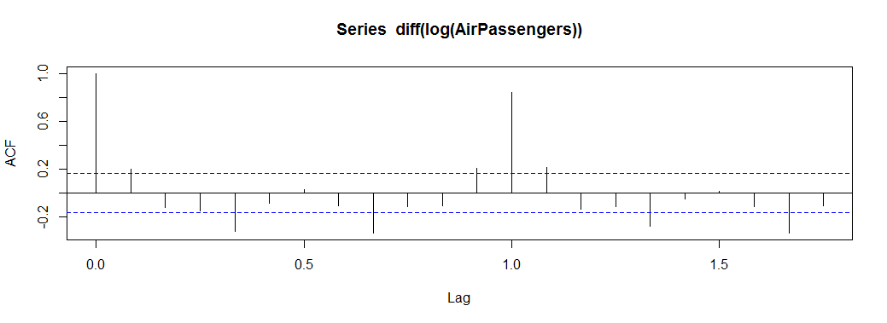
# determines value of q acf(diff(log(AirPassengers)))

Slide 27
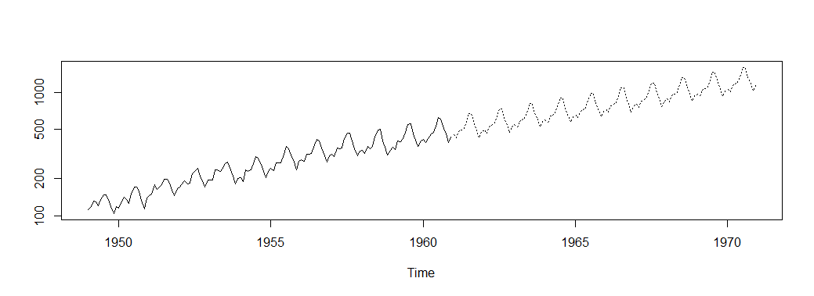
# predicting future fit<-arima(log(AirPassengers),c(0,1,1),seasonal = list(order=c(0,1,1),period = 12)) pred<-predict(fit,n.ahead = 10*12) pred1<-2.718^pred$pred ts.plot(AirPassengers,2.718^pred$pred,log = "y",lty = c(1,3))
#predicted graph

Slide 28
# testing the model
datawide<-ts(AirPassengers,frequency = 12,start=c(1949,1),end = c(1959,12))
fit<-arima(log(datawide),c(0,1,1),seasonal = list(order=c(0,1,1),period=12))
pred<-predict(fit,n.ahead = 10*12)
pred1<-2.718^pred$pred
datal<-head(pred1,12)
predicted_1960<-round(datal,digits = 0)
original_1960<-tail(AirPassengers,12)
predicted_1960
original_1960

Slide 29
# visualization
AirPassengers
barplot(predicted_1960, main="predicted values")
barplot(original_1960, main="original values")
plot(decompose(AirPassengers))

Slide 30
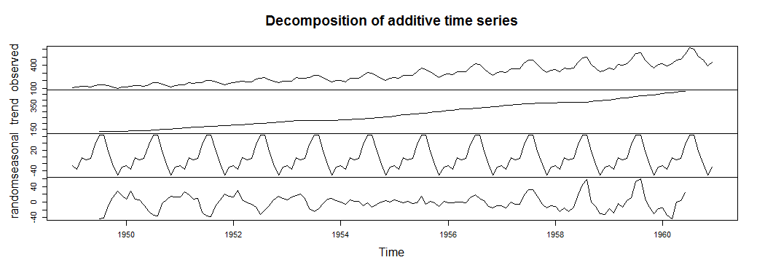
# visualization graphs

